Slide 1
Debugging in Eclipse
By
Suryaprabha K
BFS TEAM
INT0645

Slide 2
What we do actually?
Usually, while writing a piece of code, we use print statements to understand what is going on in the code.
This method is suitable for smaller and lesser complex codes, it is not the best way to understand where your code is getting stuck.
Debugging:
Debugging is a technique that is used to see the code execute line by line.
While debugging, we can see the execution line by line of the written code and can stop at any line of code.
We can analyze the code, variables, values assigned to those variables where the code stopped execution.

Slide 3
Why Debugging:
It allows software engineers and developers to fix errors in a program before releasing it to the public.
Usually, compiler errors are clearly visible while writing the code in the eclipse.
But run time errors are visible only when we execute the code and while running, if any run time error occurs, the program fails to execute and terminates abruptly.
To find the run time errors, Debugging is used.
To remove bugs, errors in the program which occurs only during specific condition.

Slide 4
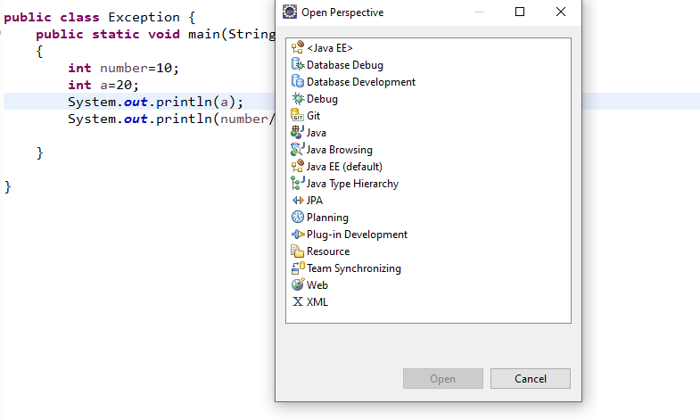
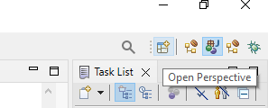
How to Launch Debugger in Eclipse ?
To launch Debugger,
Click on Open Perspective icon -> Select Debug -> Open

Slide 5
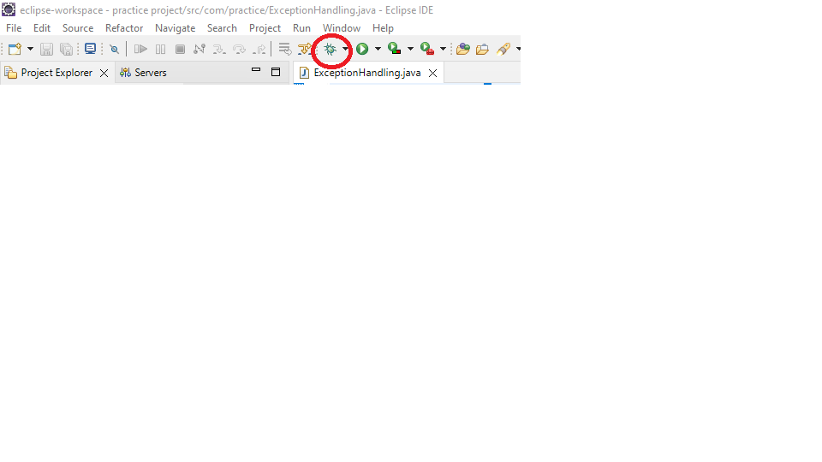
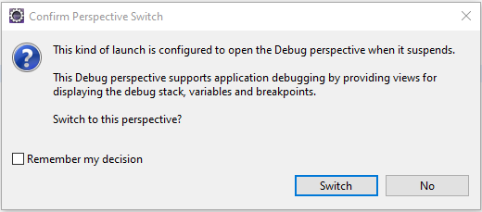
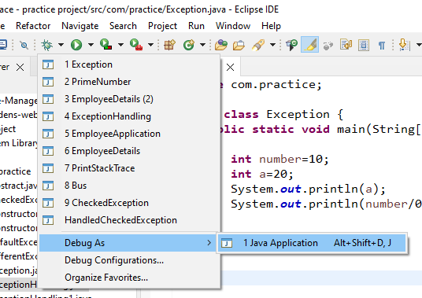
How to Debug Code in Eclipse?
Step:1
Step:3
Step:2

Slide 6
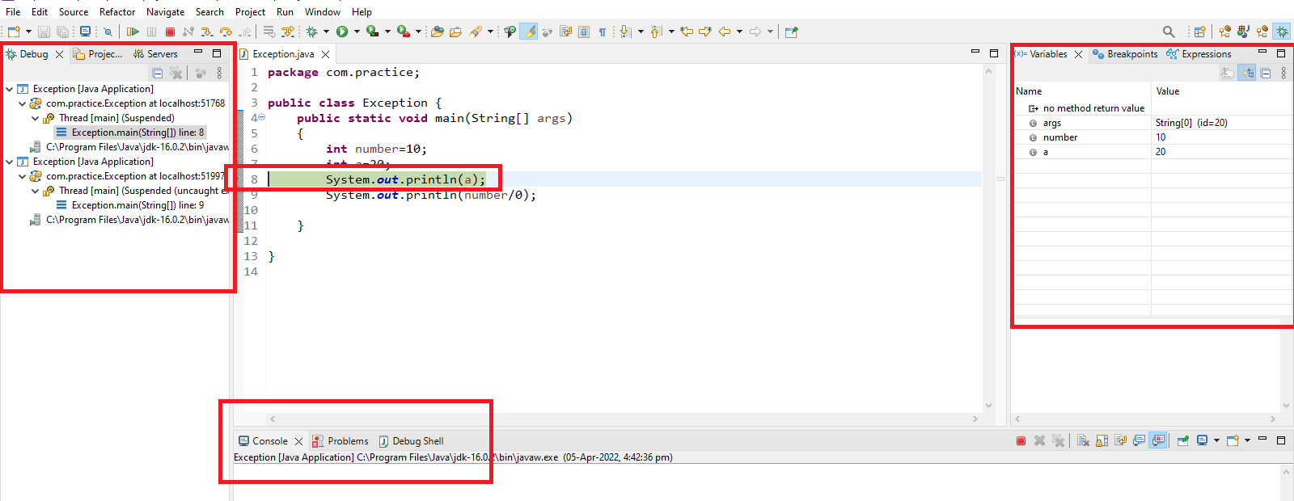
Components in Debug Perspective?
Debug Window, Variables, Console-Debug Shell, Breakpoint, Class

Slide 7
Debug Window:
Debug window is present next to the project explorer.
The class which is being debugged is displayed in the debug window.
Breakpoint:
A breakpoint is a point where the execution of the program is halted when the program is in debug mode.
Why Breakpoint?
To take manual control of a program at the time of debugging, we need breakpoint.

Slide 8
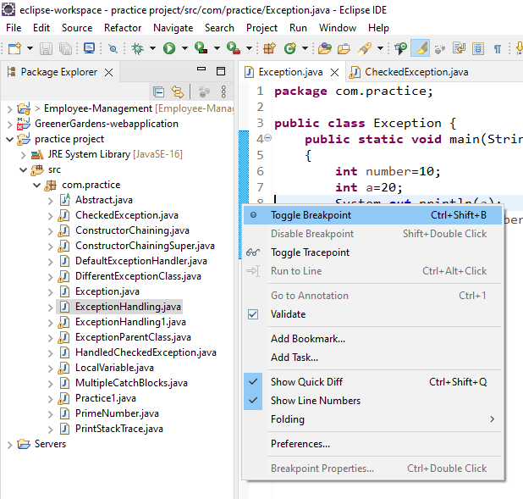
How to define a breakpoint?
To define a breakpoint in a piece of code, right click on the left margin of the line in editor and choose Toggle breakpoint.
Breakpoint is also defined by double clicking on the left margin of the line.
Shortcut Key-> Ctrl+Shift+B

Slide 9
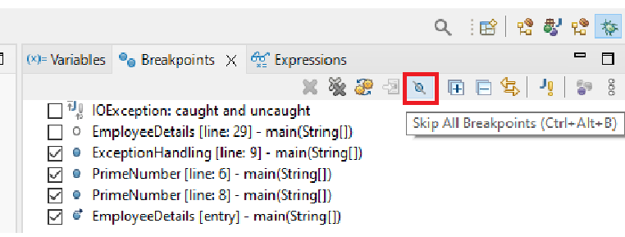
When the program execution reaches the breakpoint, the program execution gets halted.
Breakpoints view allows us to delete and deactivate the breakpoints.
All breakpoints can be enabled/disabled using Skip All Breakpoints.

